Slide 1
Magistrate Judges Best Practices Forum
May 15, 2026
Quarry Oaks Golf Club, Ashland, NE

Slide 2
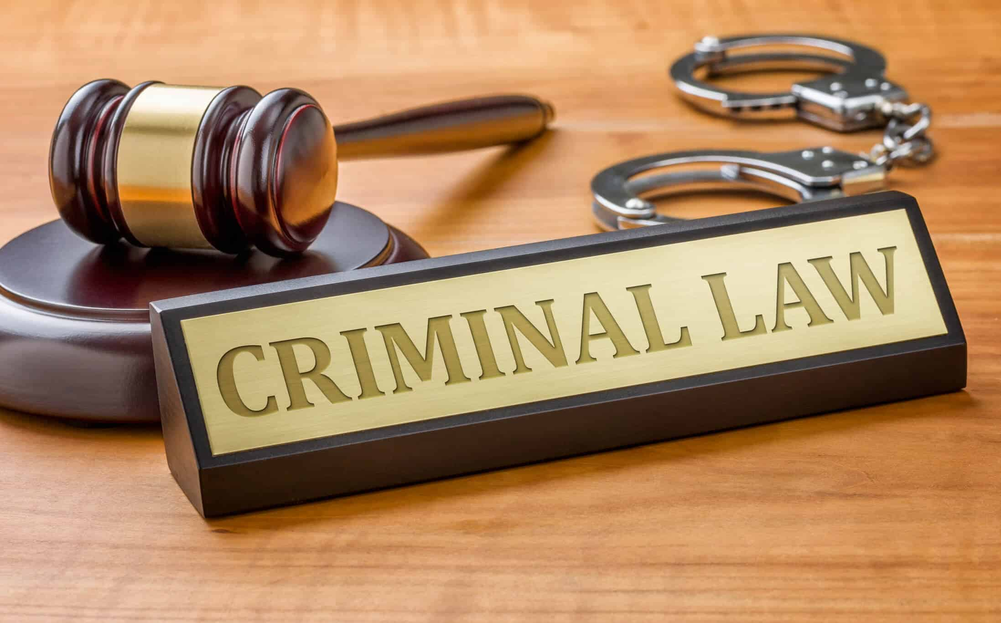

Slide 3
Opening Remarks
Chief Judge Robert F. Rossiter, Jr.
and
Magistrate Judge Ryan C. Carson
Back

Slide 4
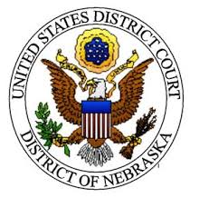
State of the Docket – Criminal Cases
Total filings in the district have increased approximately 22% from 2023-2025.
  1,222 in 2023 to 1,492 in 2025

Slide 5
State of the Docket
  Felony defendant filings increased by roughly 22% from 2023 to 2025
  The district ranks 12th nationally in felony defendant filings per district judgeship
    491 felony filings in 2025
      Drugs 136 - a decrease of approximately 28%
      Fraud 102 - an increase of over 218%
      Weapons/Firearm 63 - an increase of approximately 40%
      Criminal immigration 82 - an increase of over 134%
      Others (108)
  Median time (months from filing to disposition)
      2023- 14.6 months
      2024- 13.5 months
      2025- 11.4 months
  The Magistrate Judges handled 3,613 felony preliminary proceedings in 2025
      Ranked 8th nationally for total duties
      9th nationally for felony pretrial matters (3,336)
      16th nationally for felony preliminary proceedings (3,473)

Slide 6


United States Marshals Service
Scott Kracl – U.S. Marshal, District of Nebraska
Jaime Galindo – Chief Deputy U.S. Marshal
Ken Csipo – SDUSM, Omaha Office
Tyler Johanek – SDUSM, Lincoln Office
Omaha.operations@usdoj.gov

Slide 7
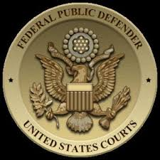
Federal Public Defender &
Criminal Justice Act
Federal Public Defender Rich McWilliams
CJA Panel Representative Peder Bartling
General Topics: Changes to the CJA Panel; Case Progression; and
Recent issues facing the Office of the Federal Public Defender

Slide 8





U.S. Attorney Lesley Woods
General Topics:
  Complex Case Designations and Procedure
  Rule 16 Discovery
  Chain of Command and Plea Agreements

Slide 9
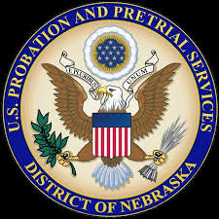
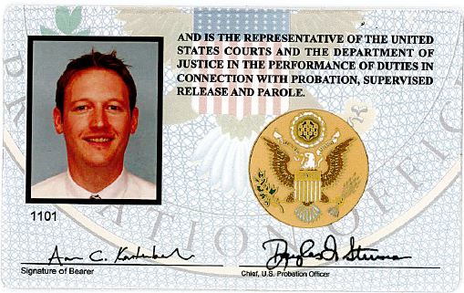
U.S. Probation and Pretrial Services
Aaron Kurtenbach, Chief

Slide 10
U.S. Probation and Pretrial Services
Chief: Aaron Kurtenbach
Deputy Chief: Kimi Camacho
Asst. Deputy Chief: Brandon Maxon
Pretrial Supervisors: Mike Sliva and Jeff Anthens (Lincoln)
Presentence Supervisors: Annalee Thomas and Chris Niles
Post Conviction Supervisors: Alicia Friedman, Kala Hayden, and Dustin Russell (Lincoln)

Slide 11
U.S. Probation and Pretrial Services
Challenges:
Decline in workload
Pretrial Unit reorganization
PSR retirements leading to lesser-experienced staff
Paid Parental Leave

Slide 12
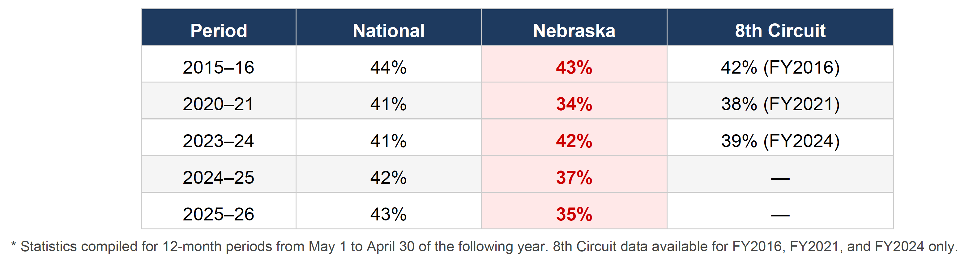
U.S. Probation and Pretrial Services

Slide 13
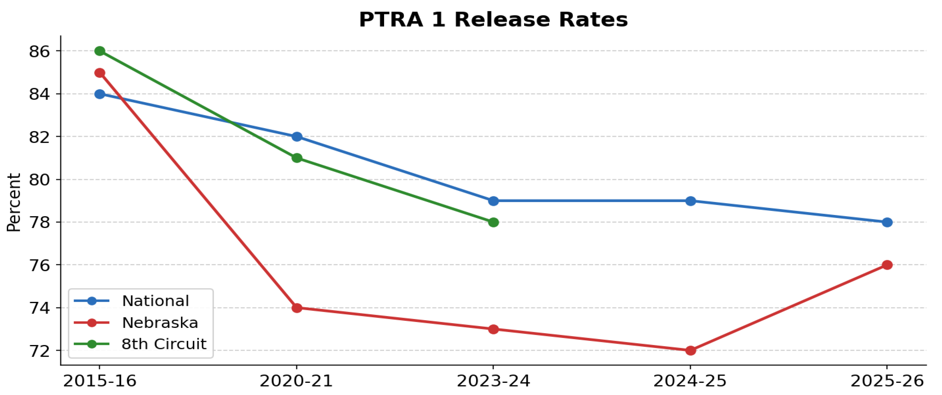
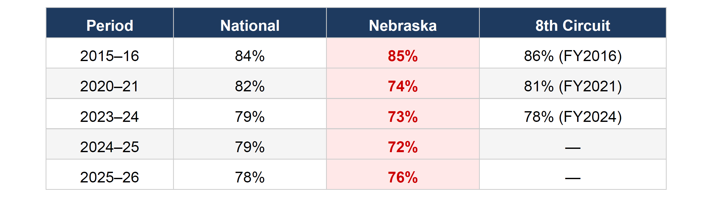
U.S. Probation and Pretrial Services

Slide 14
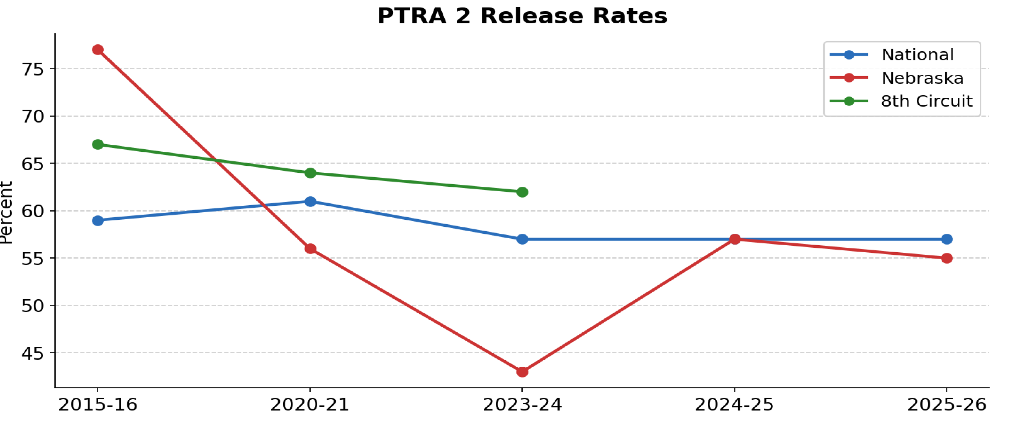
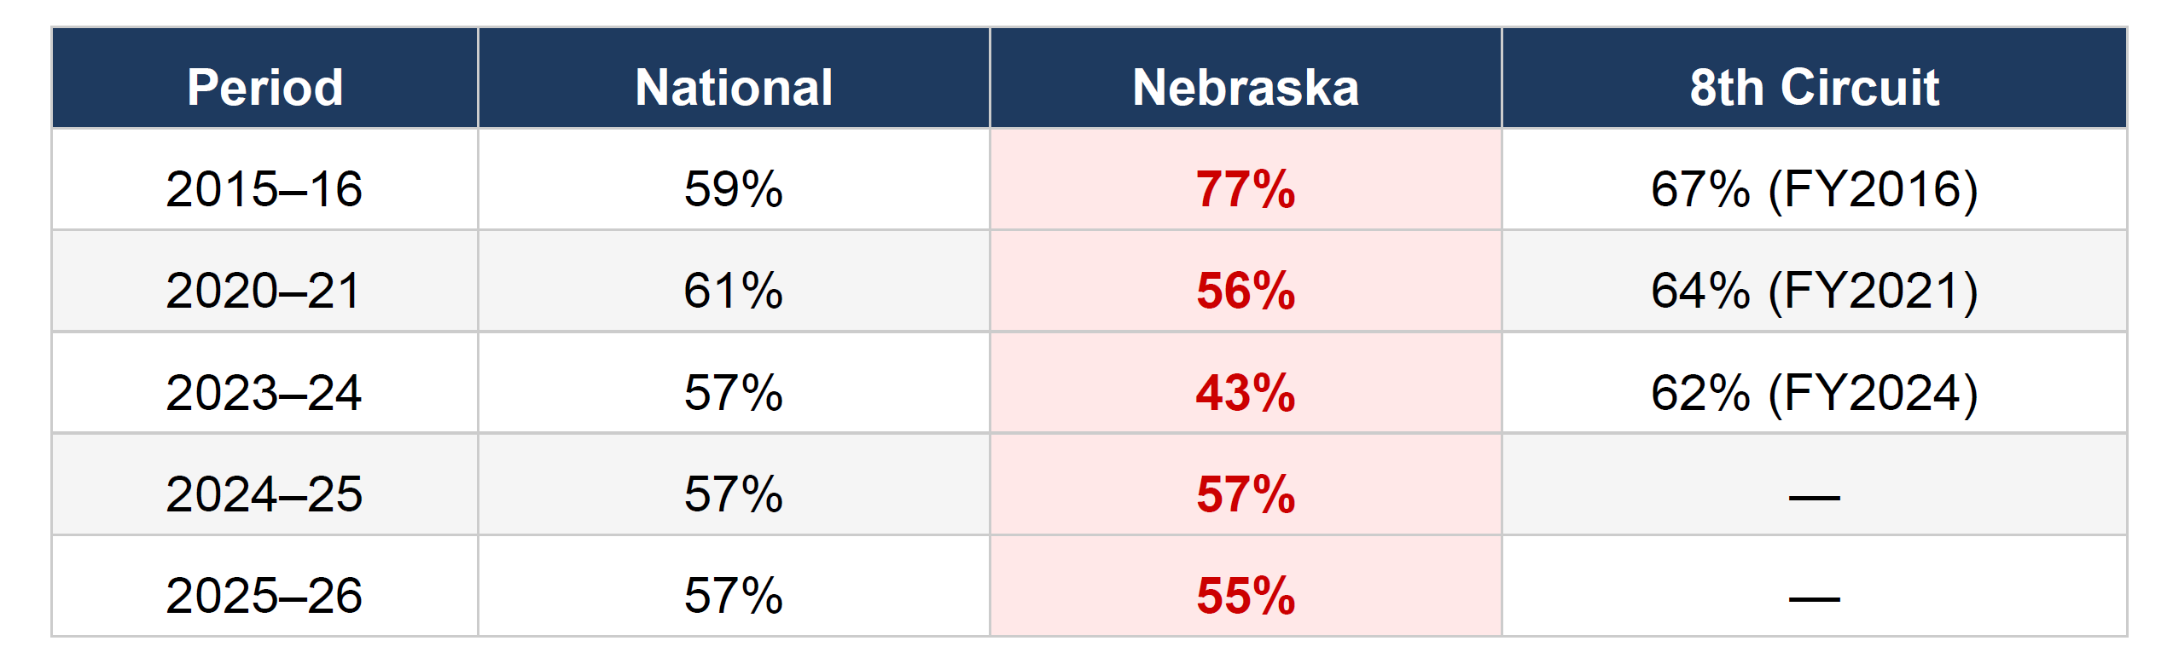
U.S. Probation and Pretrial Services

Slide 15
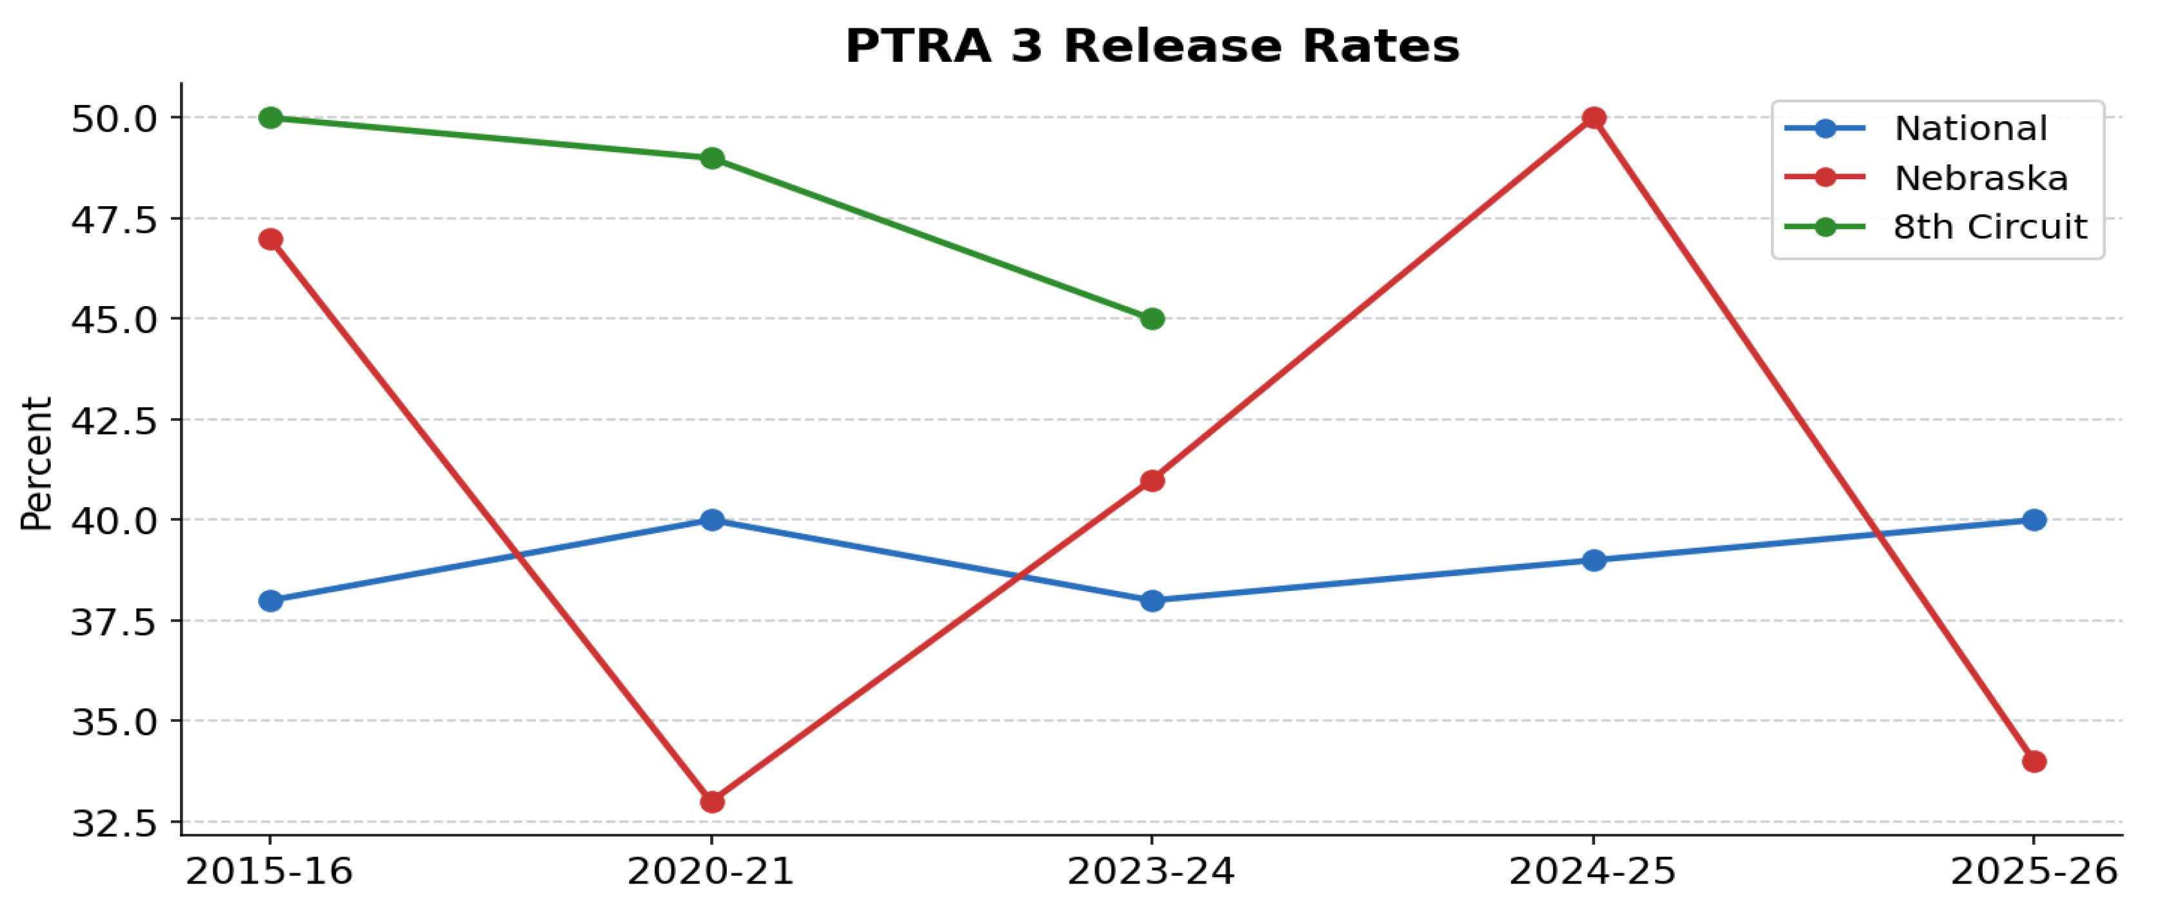

U.S. Probation and Pretrial Services

Slide 16
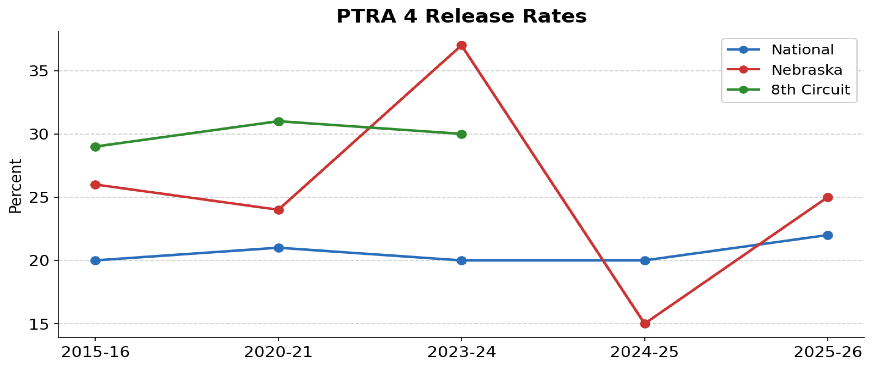
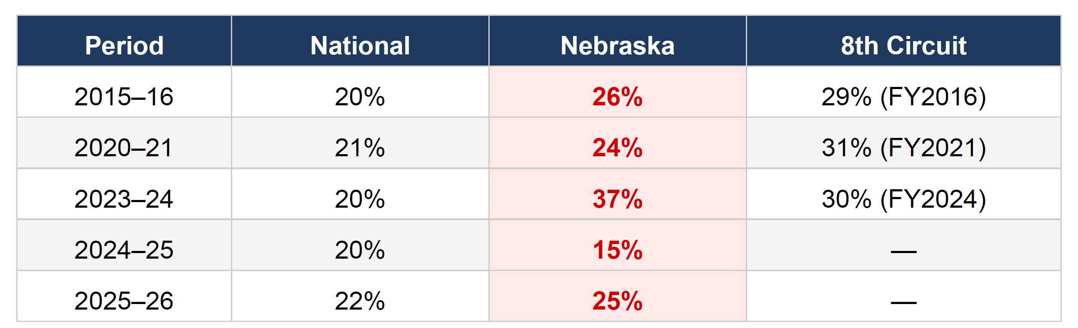
U.S. Probation and Pretrial Services

Slide 17
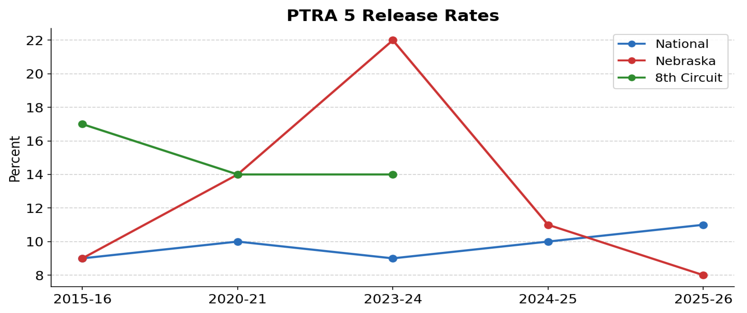
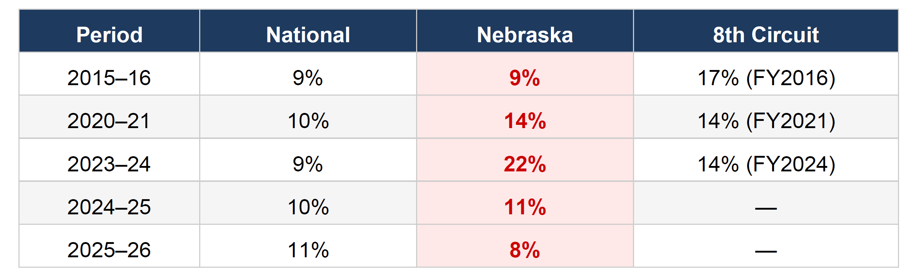
U.S. Probation and Pretrial Services

Slide 18
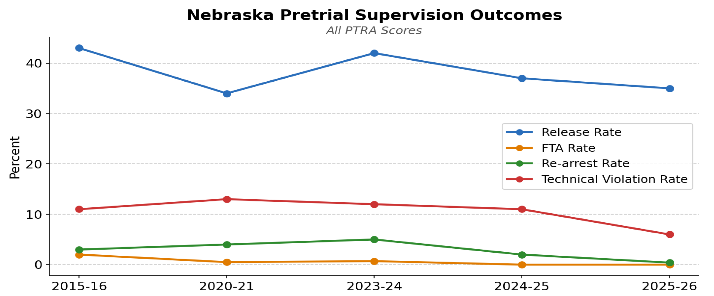
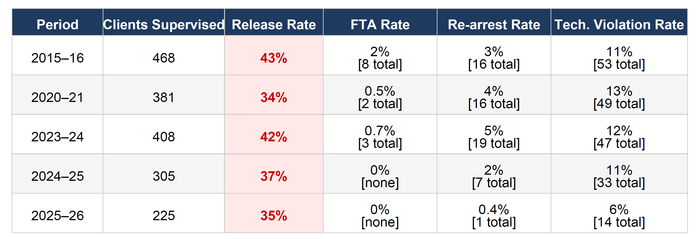
U.S. Probation and Pretrial Services

Slide 19
BREAK:
Talk at your table about any friction points you see in the Court and topics you would like us to address today

Slide 20

Representation and Scope
Rich McWilliams and Magistrate Judge Nelson
* Hybrid Representation and Standby Counsel
* Client-related issues: Filings and Local Rules

Slide 21
Defendants have a constitutional right to self-representation upon hearing. Faretta v. California, 422 U.S. 806, 835-36 (1975); United States v. Lemicy, 122 F.4th 298, 305 (8th Cir. 2024).
The court “may terminate a defendant’s right to self-representation ‘when the defendant engages in serious obstructionist misconduct.’” United States v. Luscombe, 950 F.3d 1021, 1029 (8th Cir. 2020).
A defendant does not have a constitutional right to standby counsel, but if appointed, “the role of standby counsel falls within the discretion of the district court.” United States v. Lemicy, 122 F.4th 298, 306 (8th Cir. 2024); United States v. Webster, 84 F.3d 1056, 1063 (8th Cir. 1996).
Standby counsel may not make or interfere with significant tactical decisions or “speak instead of the defendant on any matter of importance.” McKaskle v. Wiggins, 465 U.S. 168, 178 (1984) (emphasis in original). Moreover, standby counsel may not undermine the jury’s perception that the defendant is representing himself. Id.
The American Bar Association has attempted to provide guidance on the issue of standby counsel, delineating two types: standby counsel appointed to actively assist a defendant and standby counsel appointed to assist only upon request from a defendant. ABA Standards for Criminal Justice, Defense Function, Standard 4-3.9.
Each United States district court, with the approval of the judicial council of the circuit, shall place in operation throughout the district a plan for furnishing representation for any person financially unable to obtain adequate representation in accordance with this section. Representation under each plan shall include counsel and investigative, expert, and other services necessary for adequate representation. 18 U.S.C. § 3006A.
The Criminal Justice Act may not authorize the payment of the standby counsel because the statute only authorizes compensation for “representation.” United States v. Salemo, 81 F.3d 1453, 1460 (9th Cir. 1996).
Defendants are not entitled to a junior associate or law clerk. The Sixth Amendment confers two mutually exclusive constitutional rights: the right to be represented by an attorney, and the right not to be represented by an attorney. Defendants have no constitutional right to some form of hybrid or dual representation. United States v. Bartunek, Case No. 8:17cr28-RFR-SMB (citations omitted).
Standby counsel are not able to represent defendants at trial or make any arguments or statements to the Court or jury on his behalf. It is a defendant’s obligation to make any filings on his own behalf and to secure any witnesses and other evidence at trial. United States v. Spellman, Case No. 8:21cr136-BCB-SMB.

Slide 22

Client-Related Issues
Local Rule 1.3(i)
Once an attorney is appointed or retained, all further documents and other communications with the court must be submitted through the attorney, unless the court permits otherwise. Any further pro se documents or other communications submitted to the court may be (1) returned unfiled to the sending party or (2) forwarded to the sending party's attorney.

Slide 23
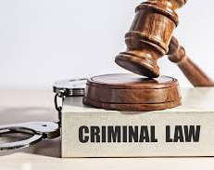
Panel Discussion
Magistrate Judges Carson, DeLuca and Nelson, Sean Lynch, Jody Mullis, and Rich McWilliams
Moderator: Peder Bartling
Possible Topics to include multi-defendant cases, electronic discovery, Rule 16 issues, Rule 17.1 Pretrial Conference, Coordinating discovery counsel, detention hearings and reopening detention
Next

Slide 24

Detention hearings and reopening
18 U.S.C. § 3142(f)
The hearing may be reopened, before or after a determination by the judicial officer, at any time before trial if the judicial officer finds that information exists that was not known to the movant at the time of the hearing and that has a material bearing on the issue whether there are conditions of release that will reasonably assure the appearance of such person as required and the safety of any other person and the community.

Slide 25
Concluding Remarks
Back

